Slide 1
ENHANCING DIABETES PREDICTION USING EXPLAINABLE AI
VIBHA GAUTAM 2023004512 (37)

Slide 2

AGENDA
ABSTRACT AND KEYWORDS
INTRODUCTION
PROBLEM DEFINITION
DATA DESCRIPTION
LITERATURE SURVEY
METHODOLOGY
EVALUATION
HELPING SOCIETY
FUTURE SCOPE
CONCLUSION

Slide 3

ABSTRACT
We apply Explainable AI (XAI) techniques alongside deep learning to predict diabetes. Deep learning models, while accurate, often lack interpretability, limiting their use in healthcare. This project integrates XAI methods like SHAP and LIME to enhance transparency and provide clear, actionable predictions. The results show that explainable models can balance accuracy with interpretability, offering crucial insights for clinical decision-making and improving trust in AI-driven healthcare solutions.
KEYWORDS
Explainable AI, Deep Learning, Diabetes Prediction, SHAP, LIME, DICE, Healthcare, Interpretability, Machine Learning, Clinical Decision-Making, Transparent Models.

Slide 4
INTRODUCTION
AI has revolutionized healthcare, particularly in disease prediction and treatment. Diabetes, a leading cause of death globally, often requires early detection, which traditional methods may not provide. While deep learning models have advanced diabetes prediction, their "black-box" nature makes them difficult to trust. By integrating XAI techniques, we can enhance both accuracy and transparency, making these models more reliable in clinical practice.

Slide 5

PROBLEM DEFINITION
Deep learning models have shown promise in predicting diabetes, but their lack of transparency hinders their adoption in healthcare. The "black-box" nature of these models prevents healthcare professionals from understanding and trusting ai-driven predictions, which is crucial for clinical decision-making.
OBJECTIVES
Develop a Predictive Model
Integrate Explainable AI techniques
Evaluate the model
Recommend Personalized Interventions
Enhance Trust and adoption in healthcare

Slide 6
LITERATURE SURVEY
Name | Techniques | Insights
Towards Transparent Diabetes Prediction: Unveiling the Factors with Explainable AI | - Explainable AI (XAI) techniques: SHAP (SHapley Additive exPlanations), LIME (Local Interpretable Model-agnostic Explanations) - Machine learning models (e.g., decision trees, neural networks) - Data preprocessing techniques (e.g., SMOTE for balancing datasets) | - Feature Importance: Glucose levels and BMI identified as most influential features for diabetes risk prediction. - Generalizability Challenge: Models performed well on the PIMA dataset but may not generalize to other populations. - Data Preprocessing: Robust preprocessing is critical for model performance; issues like data imbalance and missing values must be addressed. - XAI Effectiveness: SHAP and LIME are effective but need to be more intuitive for broader clinical use. - Real-World Potential: Integrating AI models with mobile apps and IoT devices could enable continuous and personalized diabetes monitoring

Slide 7
LITERATURE SURVEY
Name | Techniques | Insights
Scalable and Accurate Deep Learning with Electronic Health Records | Gradient Boosting Machines (GBM), Logistic Regression, Random Forest, Rpart | GBM: AROC of 84.7%. Significant predictors: fasting blood glucose, HDL, BMI, triglycerides; emphasizes explainability using XML-based formats.
Metrics for Explainable AI: Challenges and Prospects | Various Explainable AI (XAI) metrics | Discusses challenges in XAI, trade-offs between accuracy and interpretability, future research directions.
An Intelligent Approach for Diabetes Classification, Prediction, and Description | Ensemble classifiers, advanced algorithms | Focuses on improving prediction accuracy and transparency to aid clinical decision-making.
Machine Learning Methods to Predict Diabetes Complications | Machine learning techniques for complication prediction | Identifies key predictors for complications; emphasizes the importance of model interpretability for clinical application.
Explainable AI for Medical Diagnosis: An Overview and Case Study | Explainable AI techniques applied to medical diagnosis, particularly diabetes prediction | Provides insights on making AI models interpretable and trustworthy in medical contexts.

Slide 8
GAP IDENTIFICATION
Real Time Integration:
While many papers discuss the theoretical aspects of applying deep learning models and explainable AI techniques, there is a noticeable gap in research that integrates these approaches in real-time clinical environments.
Comprehensive Metrics:
While some papers discuss metrics for evaluating the effectiveness of XAI, there is a lack of comprehensive evaluation frameworks that consider the unique needs of healthcare.

Slide 9

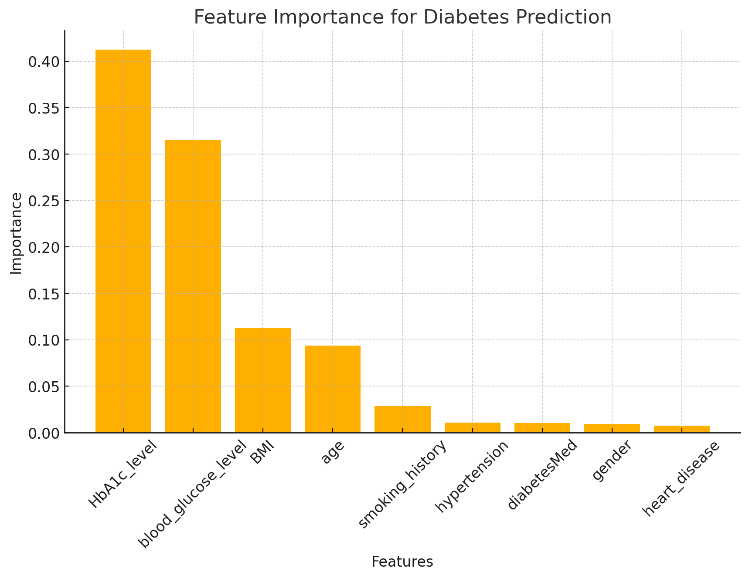
DATA DESCRIPTION
https://ieee-dataport.org/documents/diabetics-dataset
Data has 16 features with 1 target value
Scope: focus on patient information, including demographic details, medical history, and medication use
Variables: Likely includes patient demographics, medical history, lab results, medications, treatments, and outcomes.

Slide 10



METHODOLOGY
Model Development
  Preprocessing
  Training
Explainability
  SHAP
  LIM
  EDiCE
Compare
  Interpretability
  Consistency
  Actionability

Slide 11
EVALUATION
Accuracy: 0.9705 - Loss: 0.0844
Top Influencing Features: The SHAP explanation identifies HbA1c_level, miglitol, repaglinide, and insulin as key features affecting the prediction. For instance: Low HbA1c_level (around -1.89 standardized) heavily favors the "No Diabetes" prediction. The presence of medications like miglitol and repaglinide contributes toward the "Diabetes" prediction.
The counterfactuals show that to shift the prediction from "Diabetes" to "No Diabetes," certain features need adjustments, such as: The categorical feature group was changed to 2 in all generated counterfactuals. Features like insulin and HbA1c_level play a critical role, as they are adjusted to reflect the non-diabetic status.

Slide 12
IMPACT ON SOCIETY
Early Detection and Prevention
Informed Decision-Making
Personalized Treatment Plans
Healthcare Accessibility
Overall, this project aims to improve the quality of healthcare by making AI tools more
accurate, transparent, and actionable, ultimately leading to better health outcomes and
increased trust in AI technologies.

Slide 13
FUTURE WORK
Integration with Wearable Technology
Personalized Medicine
Scalability and Global Implementation
Real-Time Clinical Implementation
Comprehensive Evaluation Framework
Patient-Centric AI Solutions

Slide 14
REFERENCES
H. Byeon, "Towards Transparent Diabetes Prediction: Unveiling the Factors with Explainable AI," [Online]. Available: https://www.researchgate.net/publication/380894283_Towards_Transparent_Diabetes_Prediction_Unveiling_the_Factors_with_Explainable_AI.
M. T. Liu, M. D. Gibbons, S. A. Ghaffari, A. Q. Najeeb, and S. Q. Sami, "Scalable and accurate deep learning with electronic health records," npj Digital Medicine, vol. 1, no. 1, pp. 1-10, Feb. 2018. [Online]. Available: https://www.nature.com/articles/s41746-018-0029-1.
M. T. Ribeiro, S. Singh, and C. Guestrin, "Metrics for Explainable AI: Challenges and Prospects," arXiv preprint arXiv:1812.04608, Dec. 2018. [Online]. Available: https://arxiv.org/abs/1812.04608.
K. E. Toulis and J. Brown, "An Intelligent Approach for Diabetes Classification, Prediction, and Description," in Machine Learning and Knowledge Discovery in Databases, Springer, Cham, 2016, pp. 291-304. [Online]. Available: https://link.springer.com/chapter/10.1007/978-3-319-28031-8_28.
D. M. Goodney et al., "Machine Learning Methods to Predict Diabetes Complications," Diabetes Care, vol. 40, no. 9, pp. 1165-1170, Sept. 2017. [Online]. Available: https://pubmed.ncbi.nlm.nih.gov/28494618/.
A. Carletti, D. Poole, and S. Yuan, "Explainable AI for Medical Diagnosis: An Overview and Case Study," arXiv preprint arXiv:2304.04780, Apr. 2023. [Online]. Available: https://arxiv.org/pdf/2304.04780.

Slide 15

THANK YOU

